Slide 1

TEAM NEUTRINO​

Slide 2

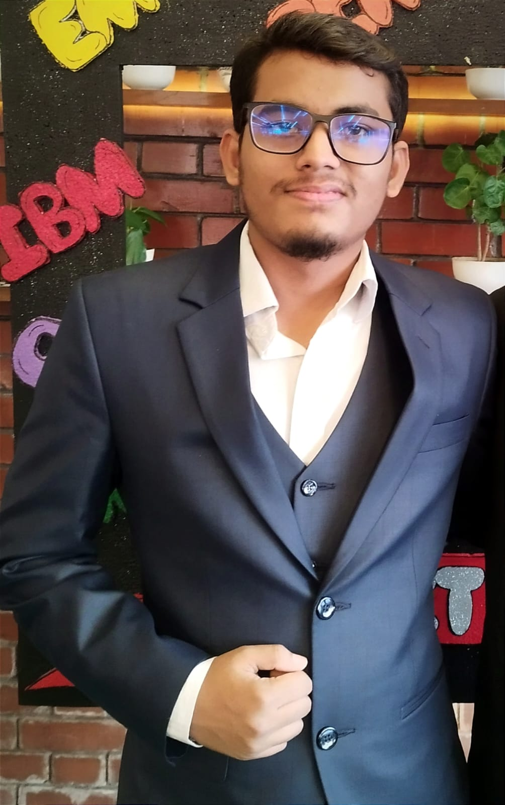


Team Members
Ovi Penheiro
Sayma Roushan
Eysha Afzal
Military Institute of Science and Technology
Military Institute of Science and Technology
Military Institute of Science and Technology

Slide 3
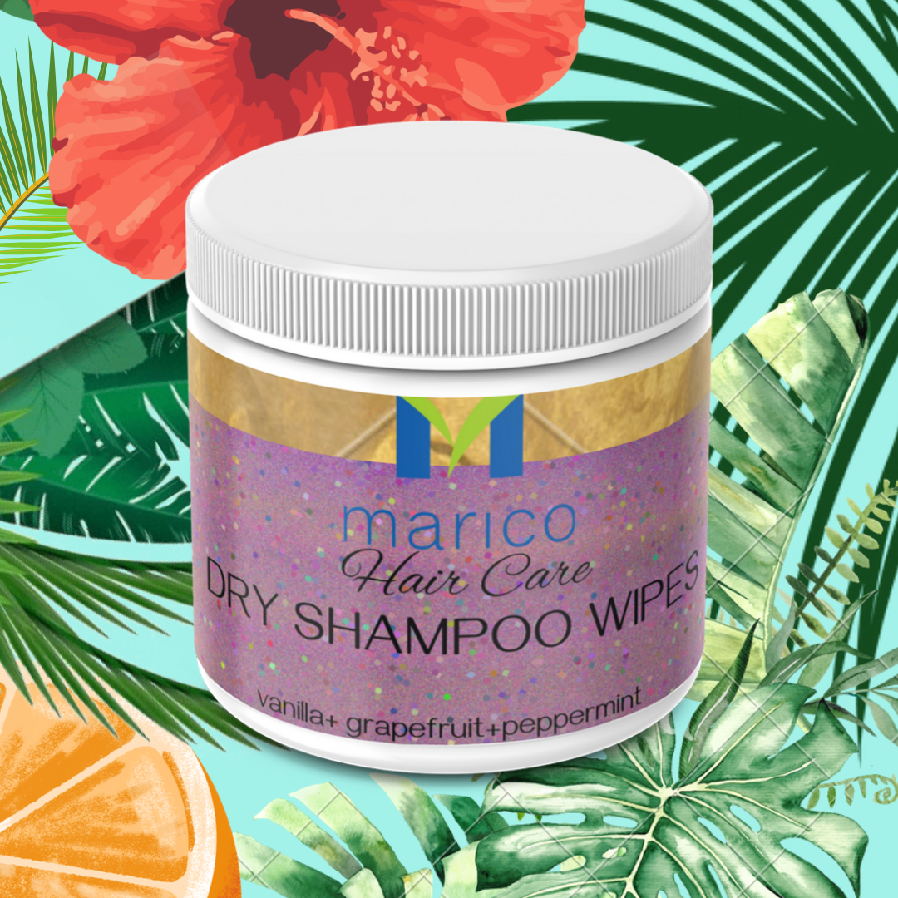
Our Business Proposal: Dry Shampoo Wipes
Dry Shampoo Wipes are an innovative, on-the-go solution for people with busy lifestyles who need to refresh their hair without the hassle of traditional shampooing. Positioned under the Parachute or Livon brand, this product combines convenience, hair nourishment, and sustainability in one package. With the increasing popularity of waterless beauty products, this offering taps into a growing market segment.

Slide 4
Competitive Landscape of Dry Shampoo Wipes
Brand | Product Name | Pricing (Approx.) | Market Growth | Demand | Unique Features | Target Audience
Dove | Care Between Washes Go Active Dry Shampoo Wipes | $5-$7 per pack | High | High | Trusted brand, effective oil absorption | Busy professionals, gym-goers, travelers
Hair by Sam McKnight | Lazy Girl Biodegradable Hair Cleanse Cloths | $8-$10 per pack | Moderate | Moderate | Biodegradable and compostable wipes | Eco-conscious & premium buyers
Yes To | Coconut Ultra Hydrating Dry Shampoo Wipe | $2-$3 per single wipe | Growing | High | Single-use, moisturizing properties | Students, young adults, travelers
Generic Brand | Convenient Ideas Shampoo Wipes | $3-$5 per pack | Steady | High | Affordable and multi-purpose | Budget-conscious users

Slide 5
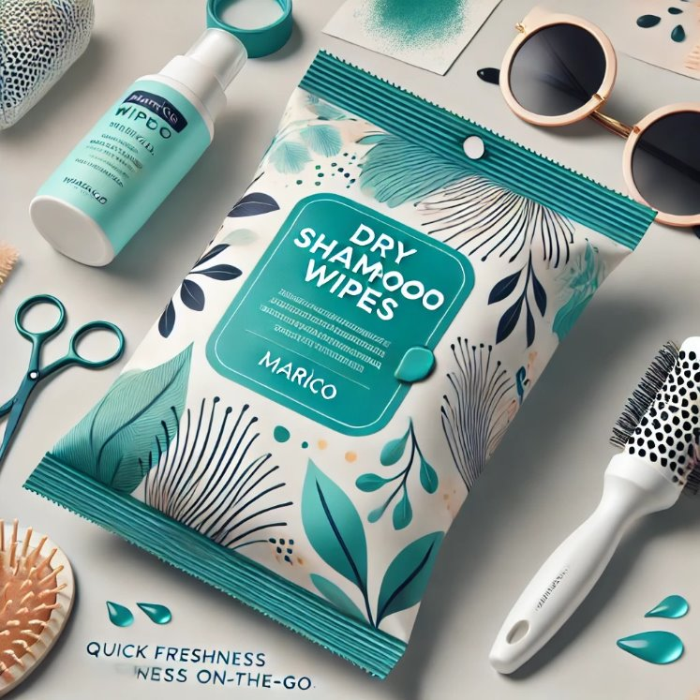
Our Big Idea: Dry Shampoo Wipes
Core Features of the product:
Instant Hair Refresh: With just one wipe, remove excess oil, dirt, and odour, leaving hair feeling fresh and clean in seconds!
Individually packaged wipes make it easy to carry and use anytime, anywhere whether at work, the gym, during travel, or after outdoor activities.
Eco-Friendly Design: Made from biodegradable materials with recyclable packaging. It offers a sustainable alternative to traditional dry shampoos.

Slide 6
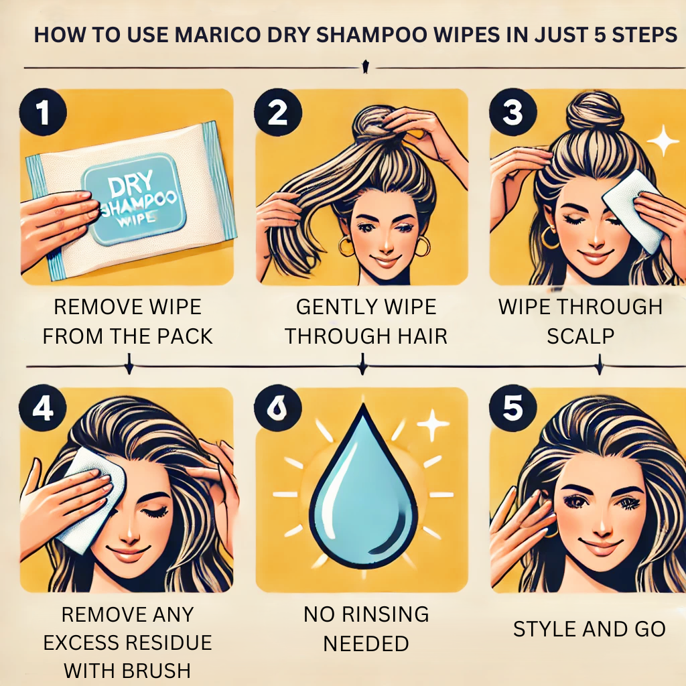
Our Big Idea: Dry Shampoo Wipes (Contd.)
Core Features of the product:
Infused with natural oils (e.g., coconut, argan) and vitamins (e.g., Vitamin E) to clean, nourish and protect the hair.
Unlike powders or sprays, the wipe format ensures no residue, making it ideal for quick touch-ups without the hassle of cleaning hair.
Available in refreshing fragrances like lavender, citrus, and coconut, or fragrance-free options for sensitive users.
Suitable for all hair types and textures, offering a lightweight formula that doesn’t weigh hair down.

Slide 7
Brand Definition and Category Fit
The Dry Shampoo Wipes brand will stand for functionality, convenience, and sustainability. It bridges the gap between effective hair care and eco-consciousness, delivering a practical, easy-to-use, and mindful of environmental impact.
Tagline: "Fresh Hair, Anywhere – The Eco-Friendly Way.“
Brand Personality:
Innovative: Pioneering a unique, portable solution in the hair care segment.
Eco-Friendly: Committed to sustainability with biodegradable materials and reduced waste.
Dependable: Offers consistent, high-quality performance for busy lifestyles
Category Fit:
Dry Shampoo Wipes fit naturally into Marico’s hair care portfolio, complementing products like Parachute Naturale Shampoo and Livon Hair Serum, which focus on nourishment, styling, and convenience. This product pioneers a portable, eco-friendly wipe format in the dry shampoo segment, establishing Marico as an innovator and creating a new niche within its hair care portfolio.

Slide 8
Market / Opportunity Size of the Idea
This product targets a growing market. Dry shampoo is becoming more popular worldwide, with more people looking for quick and easy hair care solutions. There is a high demand for portable and time-saving products in urban areas, especially where people have busy lives.
Considering these, Dry Shampoo Wipes can initially be launched in higher-income cities and later expanded to smaller towns and international markets. This product can appeal to a wide audience, making it suitable for large-scale and niche sales.
Understand Your Target Audience
Who: Urban professionals, travelers, gym-goers, and individuals with busy lifestyles. Focus on eco-conscious consumers who value biodegradable products.
Where: Metro cities, online marketplaces, and retail outlets near gyms, travel hubs, and supermarkets.
Why: Convenience, sustainability, and affordability.

Slide 9
Value Proposition of the Idea and Unique Selling Proposition
Waterless convenience for busy lifestyles.
Portable and easy to use.
Sustainable, biodegradable materials for guilt-free grooming.
What makes our product different?
This product stands out with its portable wipe format, offering a mess-free, waterless solution that combines hair refreshment with eco-friendly materials. It addresses gaps in convenience and sustainability, making it ideal for busy, modern lifestyles

Slide 10
SWOT Analysis
Strength
Weaknesses
Portable and convenient
Eco-friendly materials
Mess-free application
Higher production costs
Limited awareness of wipe format
Potential competition from dry shampoos
SW
OT
Opportunity
Threat
Eco-conscious market
Demand for On-the-Go products
First-mover advantage in Bangladesh
Consumer resistance
Competitor limitation
Regulatory challenges

Slide 11
Execution Plan

Slide 12
Marketing Task Definition
Unique Selling Proposition (USP): "Eco-friendly dry shampoo on the go: A biodegradable solution for refreshed hair anytime, anywhere."
Exclusive Launch
Online First: Launch on Marico’s owned platforms and tie-ups with major e-commerce sites
Offline Launch: Distribute the product to Marico’s existing retail and distributor network, including supermarkets, pharmacies, and beauty stores.
Teaser Campaign
Use Marico's social media channels to build anticipation before the launch with sneak peeks, countdowns, and "Coming Soon" ads.
Celebrity and Influencer Endorsements
Collaborate with beauty influencers and Marico's existing celebrity endorsers to promote the product.
Share testimonials from trusted figures, emphasizing convenience and sustainability.
Product Launch Strategy
Promotion Strategy
Digital Marketing
Social Media
Content Marketing and ads
Email Campaigns
Traditional Marketing
Sampling Campaigns
Retail Point-of-Sale Displays
Advertisements
Cross Selling
Others
Retail Promotions
CSR Campaigns

Slide 13
Sales Strategy
Online
E-commerce platforms
Niche platforms
Retail
Supermarkets
Pharmacies and salons.
Direct-to-Consumer (D2C): eg. Maricos dedicated website.
Local Cosmetic shops.
Distribution Channels
Suitable for all hair types.
Emphasize benefits
Convenience of wipes over traditional shampoo.
Eco-friendly and biodegradable, reducing waste.

Slide 14
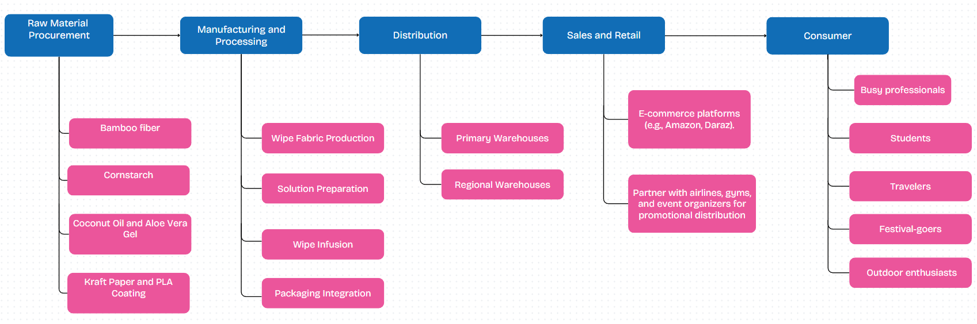
Supply Chain Strategy

Slide 15
Financial Plan

Slide 16
Revenue Model
Cost Per Unit Analysis
Selling Price per Unit Analysis
Cost Component | Cost Per Unit (BDT)
Raw Materials (Wipe + Formula) | 30
Packaging | 10
Labor & Utility | 50
Marketing | 20
Distribution | 30
Total Cost Per Unit | 140
Price Type | Price (BDT)
Wholesale Price | 250/unit
Retail Price | 499/unit
Profit Margin (Per Unit) | Wholesale: 110 Retail: 359
Break Even Analysis
We need to sell 29,233 units/year (approximately 2,436 units/month) to cover both fixed and variable costs.
At this point, the business will neither make a profit nor incur a loss.
After reaching this point, each unit sold contributes to net profit.
However, If we sell the approximated 10,000 units per month, we will break even in approximately 3 months.

Slide 17
Profit and Loss Road Map
Here is a 3 years roadmap and financial analysis of the business:
Year | Units Sold | Wholesale Revenue (BDT) | Retail Revenue (BDT) | Total Revenue (BDT) | COGS (BDT) | Gross Profit (BDT) | Operating Expenses (BDT) | Net Profit (BDT) | Key Focus Areas / Roadmap
Year 1 | 1,20,000 | 2,10,00,000 | 1,79,64,000 | 3,89,64,000 | 1,68,00,000 | 2,21,64,000 | 54,00,000 | 1,67,64,000 | Build brand awareness, achieve product-market fit.
Year 2 | 1,56,000 | 2,73,00,000 | 2,33,52,000 | 5,06,52,000 | 2,18,40,000 | 2,88,12,000 | 59,40,000 | 2,28,72,000 | Scale production, optimize distribution channels.
Year 3 | 2,01,600 | 3,67,80,000 | 3,10,57,600 | 6,78,37,600 | 2,82,24,000 | 3,96,13,600 | 65,34,000 | 3,30,79,600 | Expand into new markets, diversify product line.
All the data and references can be availed through this excel file attached in this link below. Click to proceed:
->Full Cost Analysis Excel File<-

